Slide 1

DATABASE COURSE 2023/2024
SESSION 12

Slide 2
SESSION 12
VIEWS
ORACLE MATERIALIZED VIEW
ORACLE SEQUENCES
MYSQL AUTO_INCREMENT

Slide 3
VIEWS
CREATE and DROP VIEW Syntax
MySQL/Oracle
CREATE VIEW ViewName AS
SELECT .. FROM ... WHERE ...
MySQL/Oracle
DROP VIEW ViewName

Slide 4
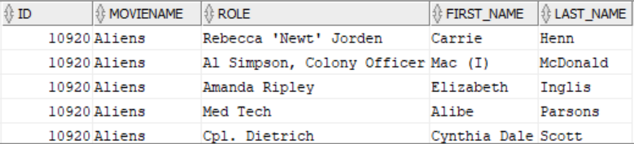
VIEWS
CREATE VIEW Example
BBDD/User: moviesmall
MySQL/Oracle
CREATE VIEW castfilm AS
SELECT ms.id, ms.name moviename, r.role,a.first_name, a.last_name
FROM moviesmall ms
LEFT JOIN role r ON (ms.id = r.movie_id)
LEFT JOIN actor a ON (r.actor_id = a.id)
ORDER BY ms.name
MySQL/Oracle
SELECT * FROM castfilm;

Slide 5

VIEWS
CREATE VIEW Example
BBDD/User: moviesmall
MySQL/Oracle
INSERT INTO moviesmall
VALUES (400000,'Transformers: Rise of the Beasts',2022,NULL);
MySQL/Oracle
SELECT * FROM castfilm WHERE id = 400000;
MySQL/Oracle
ROLLBACK;
Notes:
To check that inserting in the original table, also the view is updated

Slide 6
SESSION 12
VIEWS
ORACLE MATERIALIZED VIEW
ORACLE SEQUENCES
MYSQL AUTO_INCREMENT

Slide 7
ORACLE MATERIALIZED VIEWS
CREATE MATERIALIZED VIEW Syntax
Oracle
CREATE MATERIALIZED VIEW ViewName
BUILD BUILDAT
REFRESH REFRESHTYPE REFRESHON
AS SELECT ... FROM ... WHERE ...
BUILDAT:
IMMEDIATE. Populated at Creation
DEFERRED. Populated at first refreshing
REFRESHTYPE:
FAST. Update changes and insert new rows
COMPLETE. All the records are inserted again.
FORCE. Try first FAST and then COMPLETE
REFRESHON:
ON COMMIT. When commit is done in any internal table.
ON DEMAND. By executing: exec dbms_mview.refresh('ViewName');
START WITH … NEXT …. START WITH specifies the first refresh, and NEXT specifies the nexts refreshs.

Slide 8
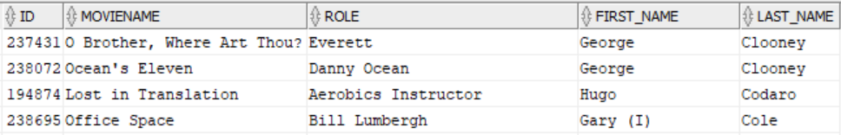
ORACLE MATERIALIZED VIEWS
CREATE MATERIALIZED VIEW Example
BBDD/User: moviesmall
Oracle
CREATE MATERIALIZED VIEW mcastfilm
BUILD IMMEDIATE
REFRESH FORCE ON COMMIT AS
SELECT ms.id, ms.name moviename, r.role, a.first_name, a.last_name
FROM moviesmall ms, role r , actor a
WHERE ms.id = r.movie_id (+)
AND r.actor_id = a.id (+);
Oracle
SELECT * FROM mcastfilm;

Slide 9
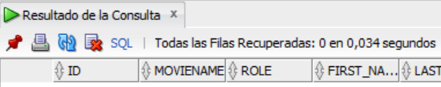
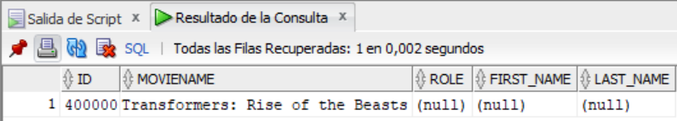
ORACLE MATERIALIZED VIEWS
CREATE MATERIALIZED VIEW Example
BBDD/User: moviesmall
MySQL/Oracle
INSERT INTO moviesmall
VALUES (400000,'Transformers: Rise of the Beasts',2022,NULL);
Oracle
MySQL/Oracle
Oracle
SELECT * FROM mcastfilm
WHERE id = 400000;
COMMIT;
SELECT * FROM mcastfilm
WHERE id = 400000;
MySQL/Oracle
DELETE moviesmall WHERE id=400000;
COMMIT;

Slide 10
ORACLE MATERIALIZED VIEWS
DROP MATERIALIZED VIEW Syntax
Oracle
DROP MATERIALIZED VIEW table
DROP MATERIALIZED VIEW Example
BBDD/User: moviesmall
Oracle
DROP MATERIALIZED VIEW mcastfilm;

Slide 11
SESSION 12
VIEWS
ORACLE MATERIALIZED VIEW
ORACLE SEQUENCES
MYSQL AUTO_INCREMENT

Slide 12
ORACLE SEQUENCES
CREATE SEQUENCE Syntax
Oracle
CREATE SEQUENCE SequenceName
START WITH StartValue
INCREMENT BY Value
MAXVALUE MaxValue
MINVALUE MinValue
CYCLE
CYCLE:
CYCLE. The sequence starts again when the MaxValue/MinValue is reached.
NOCYCLE. The sequence cannot be incremented once the MaxValue/MinValue is reached.
"CREATE SEQUENCE SequenceName" creates a sequence that starts with 1, increased by 1 with no upper limit.
Oracle
SequenceName.NEXTVAL
SequenceName.CURRVAL

Slide 13
ORACLE SEQUENCES
CREATE SEQUENCE Example
BBDD/User: mydata
Oracle
CREATE SEQUENCE id_seq
INCREMENT BY 10
START WITH 10
MINVALUE 10
MAXVALUE 100
NOCYCLE;
Oracle
CREATE TABLE tabseq
(seqval NUMBER, name VARCHAR2(40), height NUMBER);

Slide 14
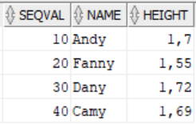
ORACLE SEQUENCES
INSERT id value by using SEQUENCE
BBDD/User: mydata
Oracle
INSERT INTO tabseq VALUES (id_seq.NEXTVAL, 'Andy', 1.7);
INSERT INTO tabseq VALUES (id_seq.NEXTVAL, 'Fanny', 1.55);
INSERT INTO tabseq VALUES (id_seq.NEXTVAL, 'Dany', 1.72);
INSERT INTO tabseq VALUES (id_seq.NEXTVAL, 'Camy', 1.69);
Oracle
SELECT * FROM tabseq;

Slide 15
ORACLE SEQUENCES
DROP SEQUENCE Syntax
Oracle
DROP SEQUENCE SequenceName
DROP SEQUENCE Example
BBDD/User: mydata
Oracle
DROP SEQUENCE id_seq;

Slide 16
SESSION 12
VIEWS
ORACLE MATERIALIZED VIEW
ORACLE SEQUENCES
MYSQL AUTO_INCREMENT

Slide 17
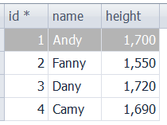
MYSQL AUTO_INCREMENT
AUTO_INCREMENT Syntax and Example
BBDD/User: mydata
MySQL
CREATE TABLE tabseq
(id INTEGER PRIMARY KEY AUTO_INCREMENT,
name VARCHAR(40),
height DECIMAL(5,3))
AUTO_INCREMENT=1;
AUTO_INCREMENT can be used on PRIMARY KEY columns only.
AUTO_INCREMENT = StartsIn. Makes the increment starts in “StartsIn” value. If no defined, takes “1” as default.
MySQL
INSERT INTO tabseq (name,height) VALUES ('Andy', 1.7);
INSERT INTO tabseq (name,height) VALUES ('Fanny', 1.55);
INSERT INTO tabseq (name,height) VALUES ('Dany', 1.72);
INSERT INTO tabseq (name,height) VALUES ('Camy', 1.69);
Notes:
The inserts should include the columns to insert:
INSERT INTO vuelo (origen, destino, duracionvuelo)
VALUES ('Madrid','Santiago de Chile',13);

